Slide 1

Team UE2

Slide 2
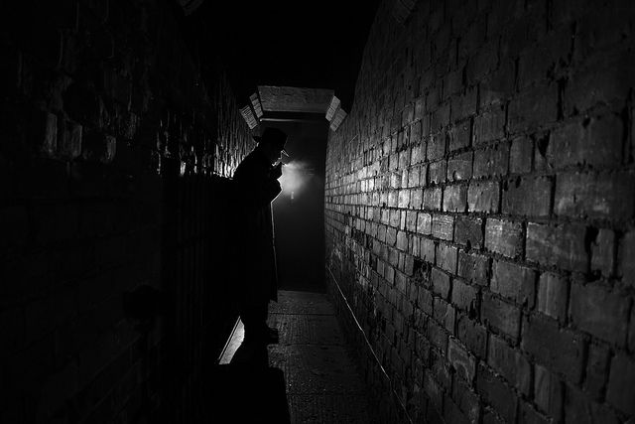
Concept
Objective-based infiltration into a vampire lair
Stealth combat game with a noir aesthetic
Limited inventory space rewards adaptability and creative usage of the player's immediate vicinity
Interactive and simulated environment with destruction physics

Slide 3
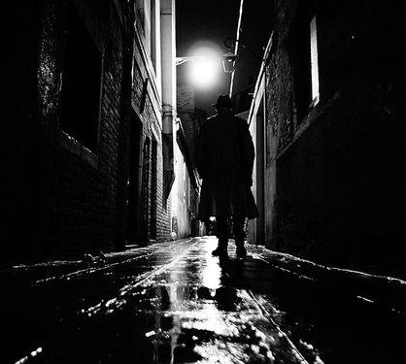
Story
Set in 1950s, post war New York
Play as Dorris, a woman turned into a half-vampire after prolonged second-hand exposure to Nostrum, a drug originating from the war that turned soldiers into vampires
She is trying to take out the boss of a mafia smuggling Nostrum, as well as rescue her husband from their clutches

Slide 4
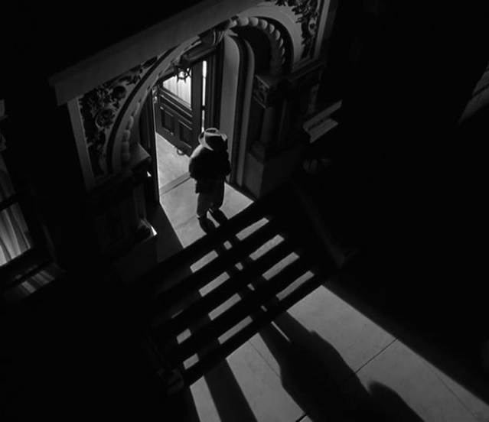
Unique Selling Points
Realistic stealth capabilities
Vampire-inspired abilities to aid the player
Stealth game with destructible environment
Immersive play with lighting engine
Complex AI behaviour
Notes:
Realistic stealth capabilities, the player has to manage line of sight, loudness as well as visibility to avoid detection, or to distract enemies enough for them to ignore the player’s presence.
Fantasy vampire inspired abilities to aid the player
Stealth game with destructible environments, contrary to other stealth games where environment is solid and no flashy actions can destroy walls.
Immersive play on lighting engine, where the fog of war ebbs and flows to obscure the vision of the player
Complex AI behavior, they live their own lives and routines during the game’s time, where each of them has their own individual work and tasks as well as needs.

Slide 5
MDA Analysis
Mechanics
Dynamics
Aesthetics
Stealth
Combat
Line of sight and Directional Audio
Interactable environment
Abilities/Inventory
Fog of War
Information Gathering
Manipulating Enemies
Redefining Space
Altering Movement
Dispatching Enemies
Sensation: Immersive environment that has good visual effects. Good lighting and satisfying explosions
Challenge: Challenging combat and frequent deaths, stealth gameplay
Discovery: proper exploration of the map allows for the players to find optimal solutions to the objectives, allowing them to appreciate the environment.

Slide 6
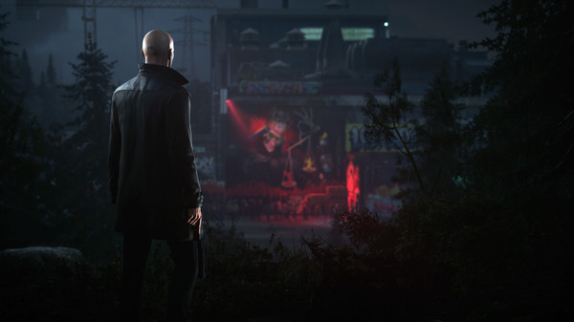
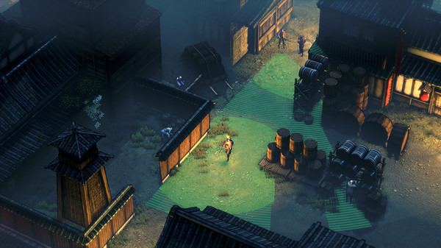
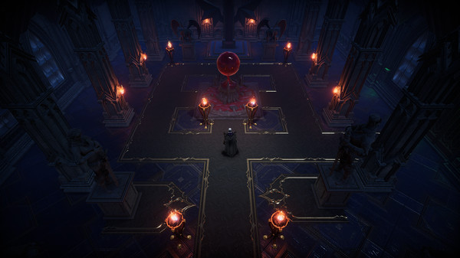
Market Research
Hitman - stealth game with strong assassination mechanics, able to guide the player into solving a puzzle game designed by the developers in order to orchestrate a murder.
Shadow Tactics - squad based RTS with stealth and puzzle mechanics meant to allow the player to play alongside the game’s rules in order to complete the game.
VRising - vampire survival with combat, crafting and base building

Slide 7
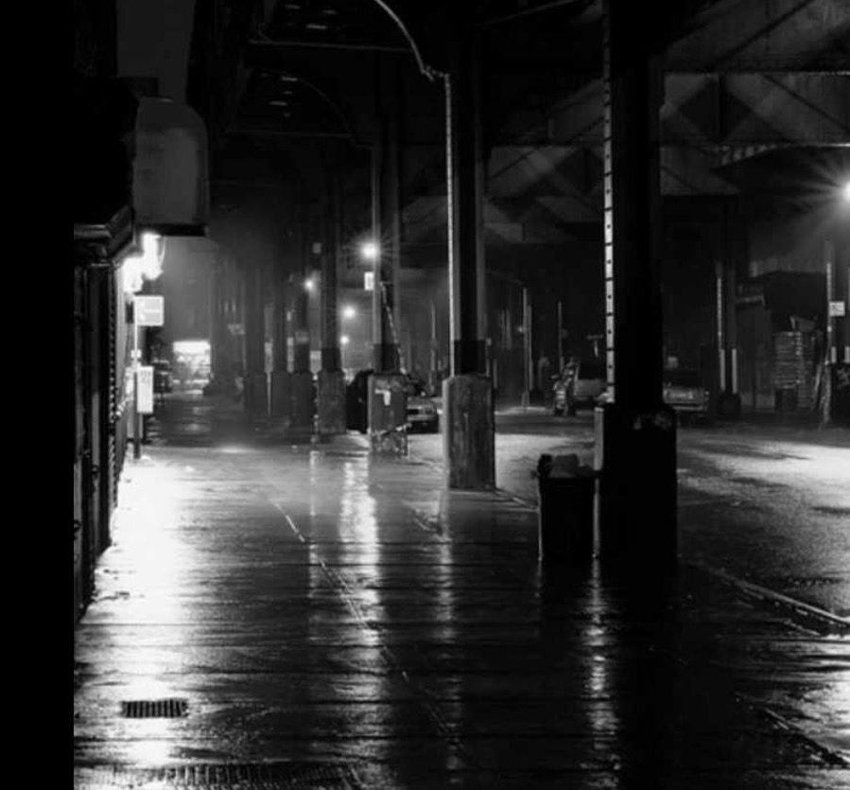
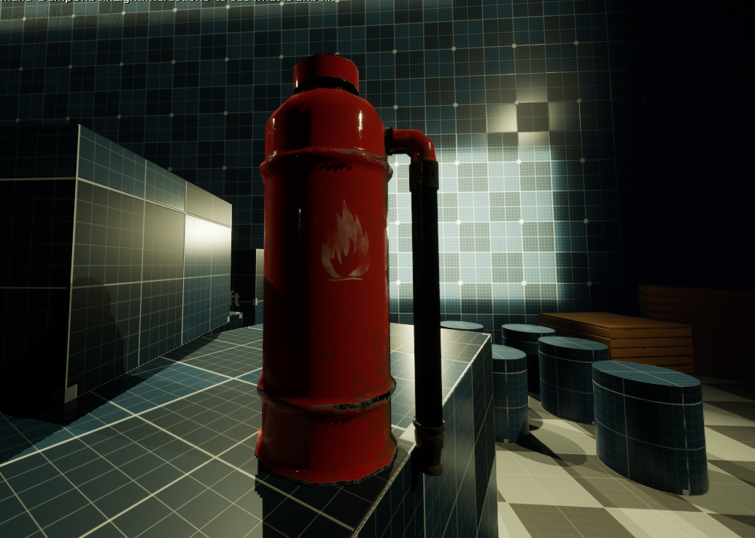
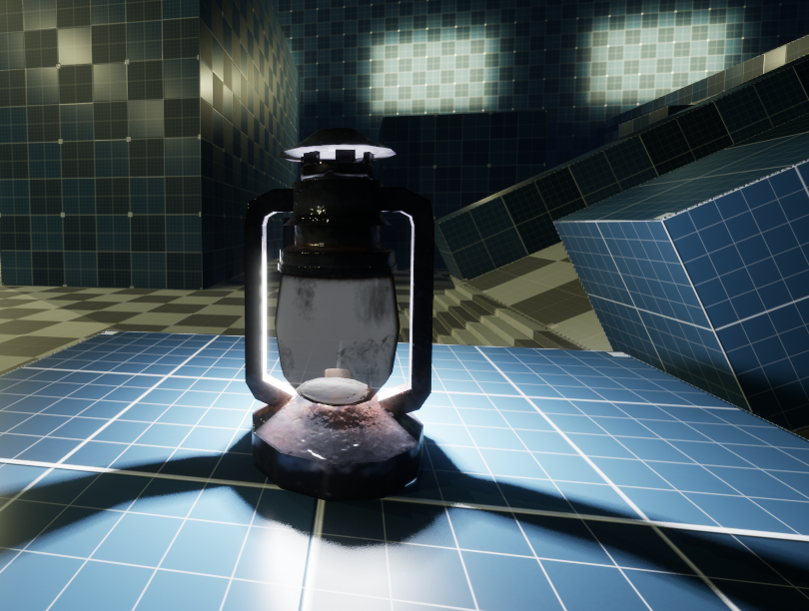
Art style
Noir themed with long/harsh shadows
Realistic textures desaturated with a filter
Slightly exaggerated normal maps to emphasise harsh lighting
Interactive objects have a colour pop to contrast with the environment

Slide 8
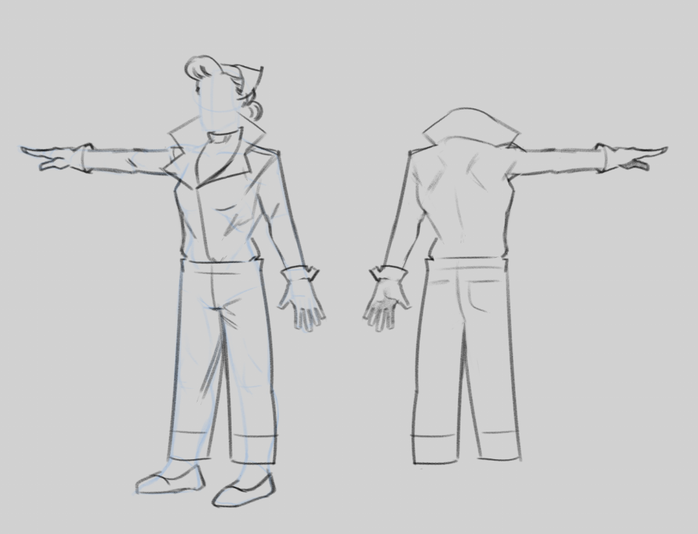
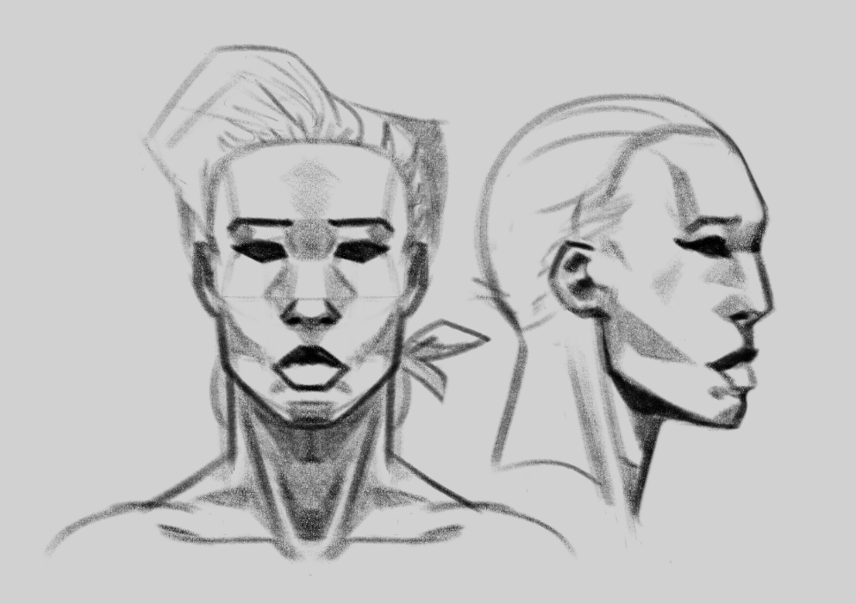
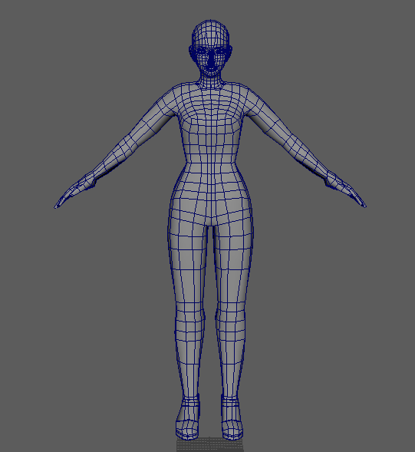
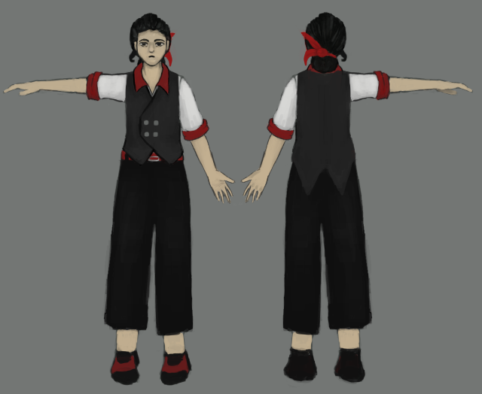
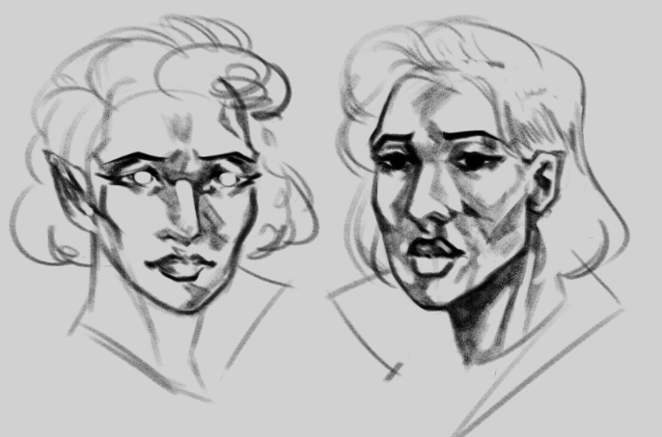
Main Character

Slide 9
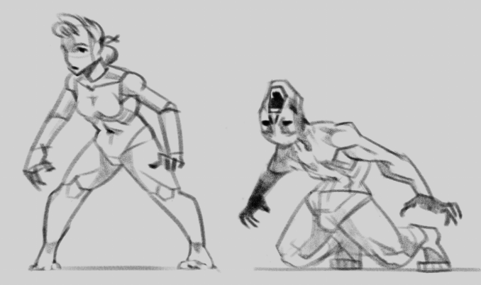
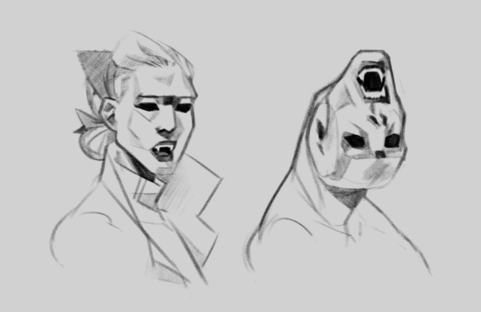
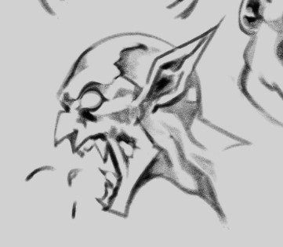
Enemies
Vampires
The main “bad guys” who run the mafia and command their human underlings
Have guns, but are also capable of hand-to-hand combat
Damaged by sunlight
Humans
Low-level employees of the mafia performing tasks like moving crates, cleaning etc
Easily frightened and will run away from players and thrulls, but will obey vampires’ commands
Thrulls
People turned into vampires
Terrible eyesight, but can smell blood as well as hear the player
Damaged by sunlight, but have little self-preservation and will chase targets into the sun anyway

Slide 10
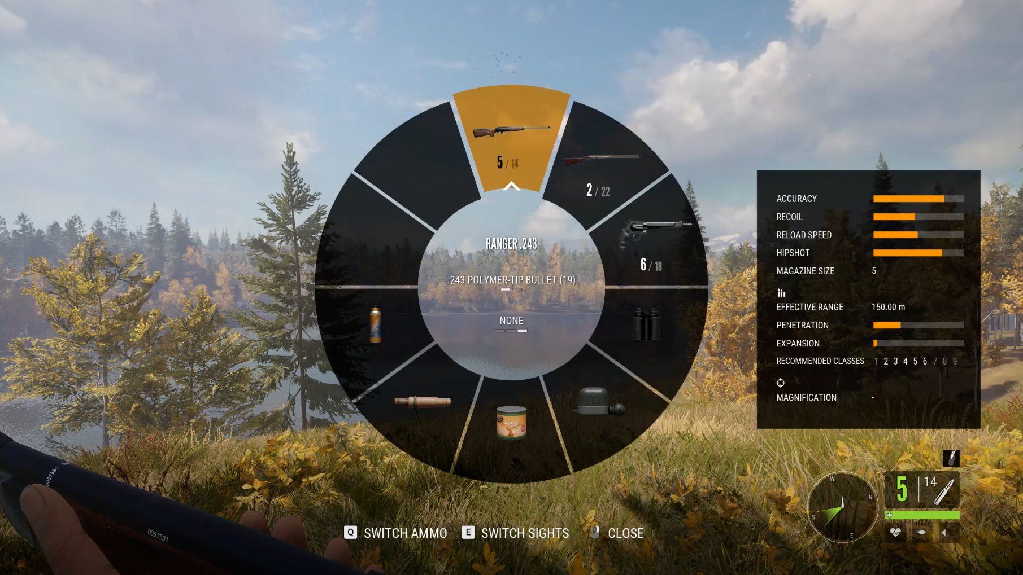
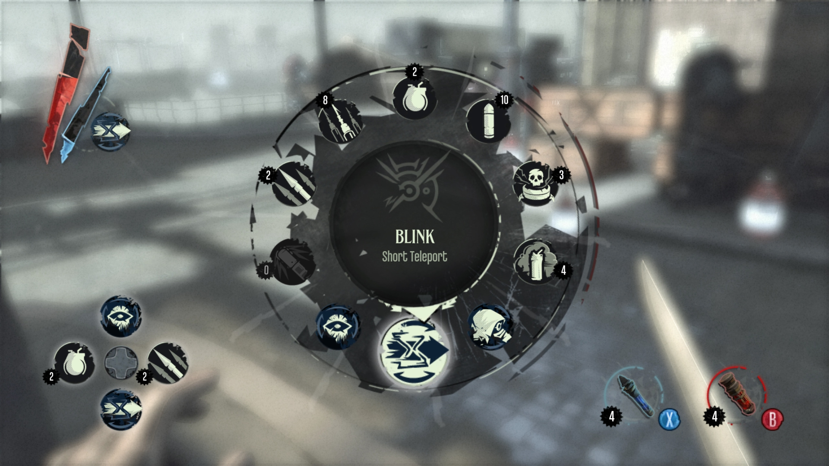
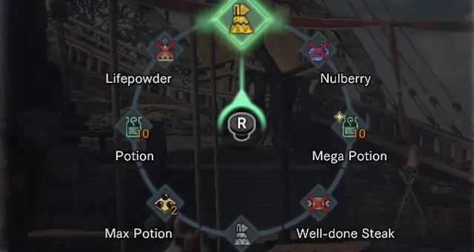
UIUX - World Interface
Radial Menu
Quick Equip
Limited Slot
Tooltip On Hover

Slide 11
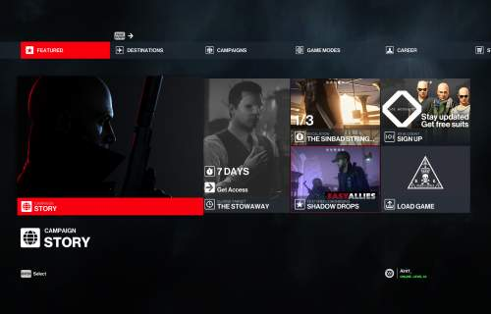
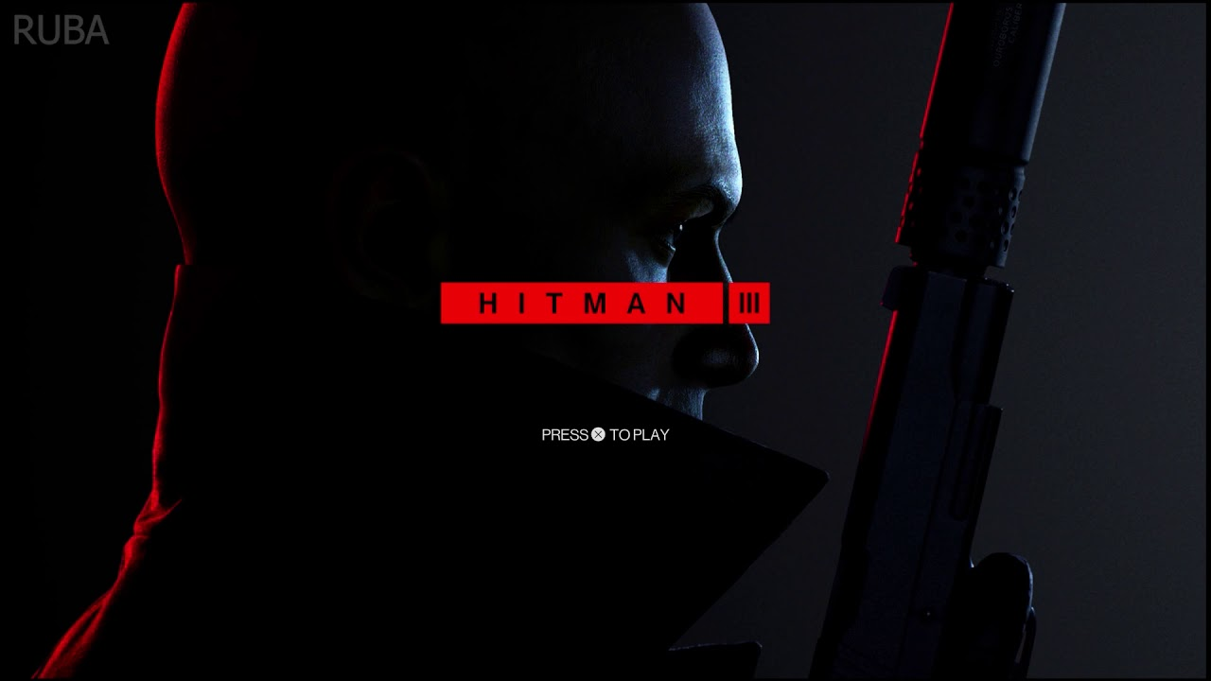
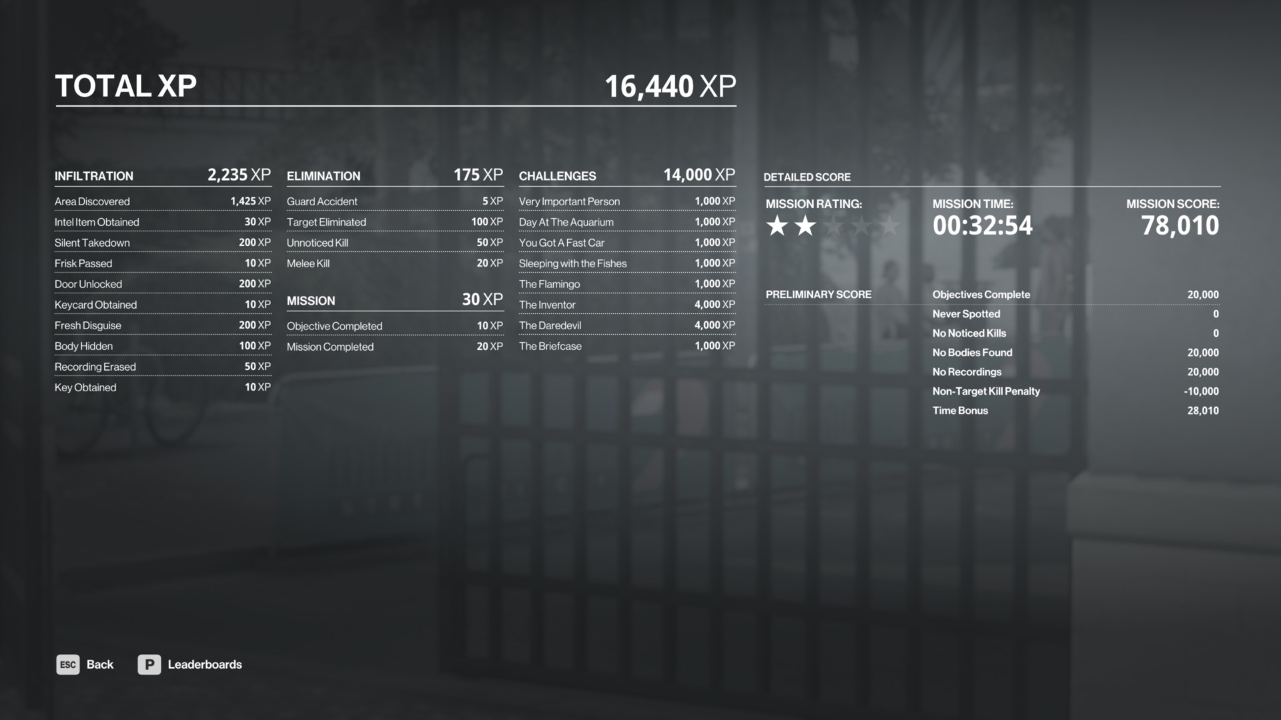
UIUX - Scenes
Clean Block Based UI
Minimalistic Design
Sharp Colors for Contrast
Animated Background

Slide 12
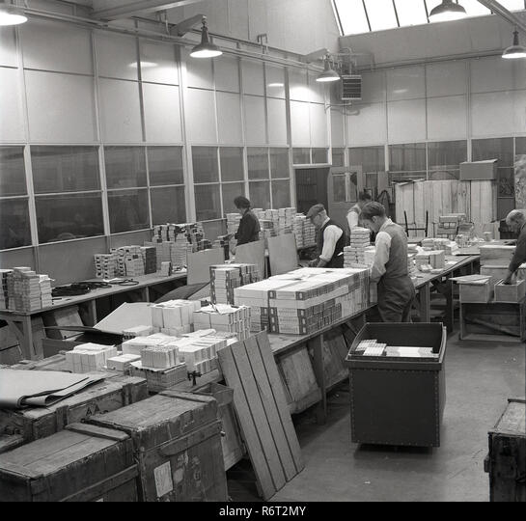
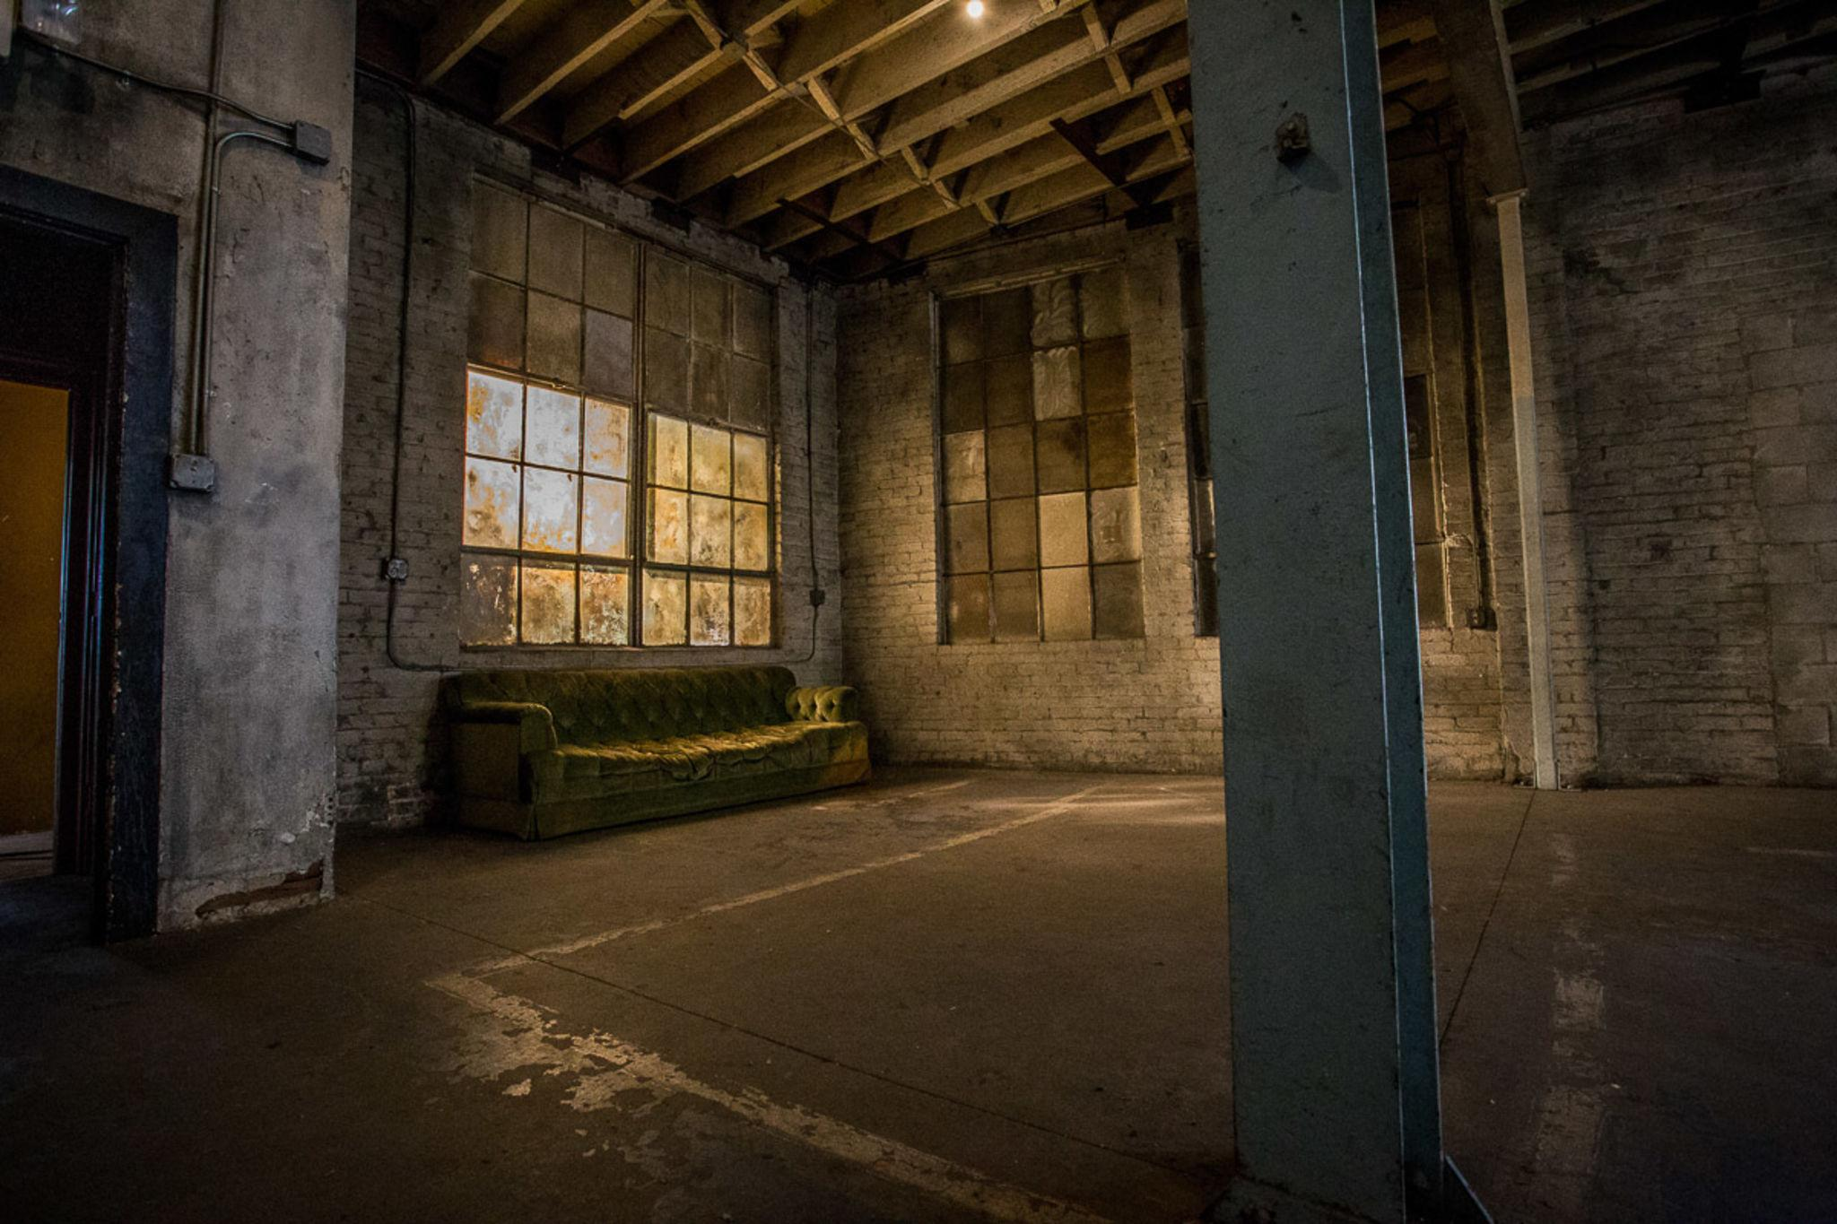

Level Design
Shady warehouse used as part of a smuggling operation
Daytime, with light coming in from grimy windows
Additional light indoors from small lanterns and spotlights

Slide 13
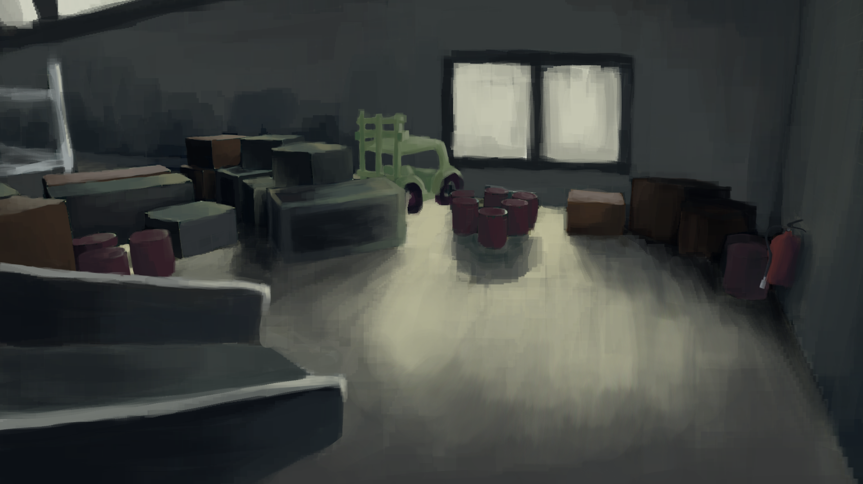
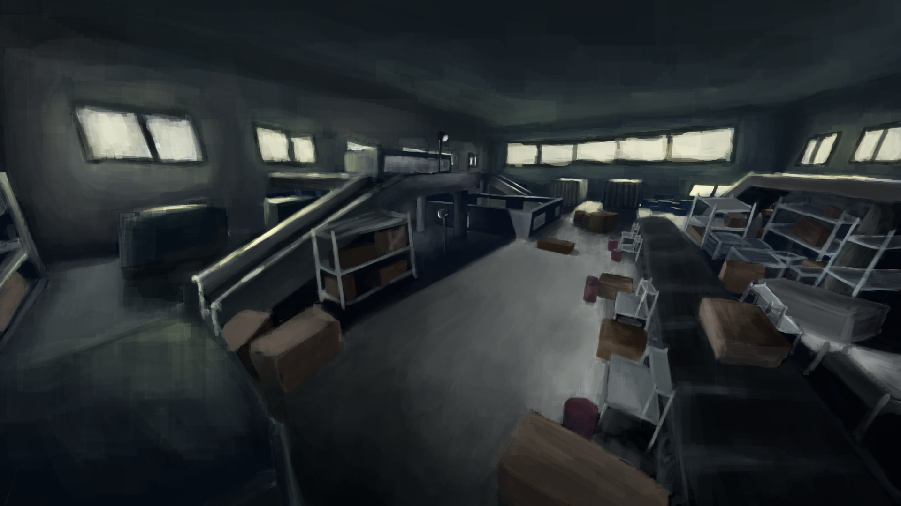
Concept Art

Slide 14
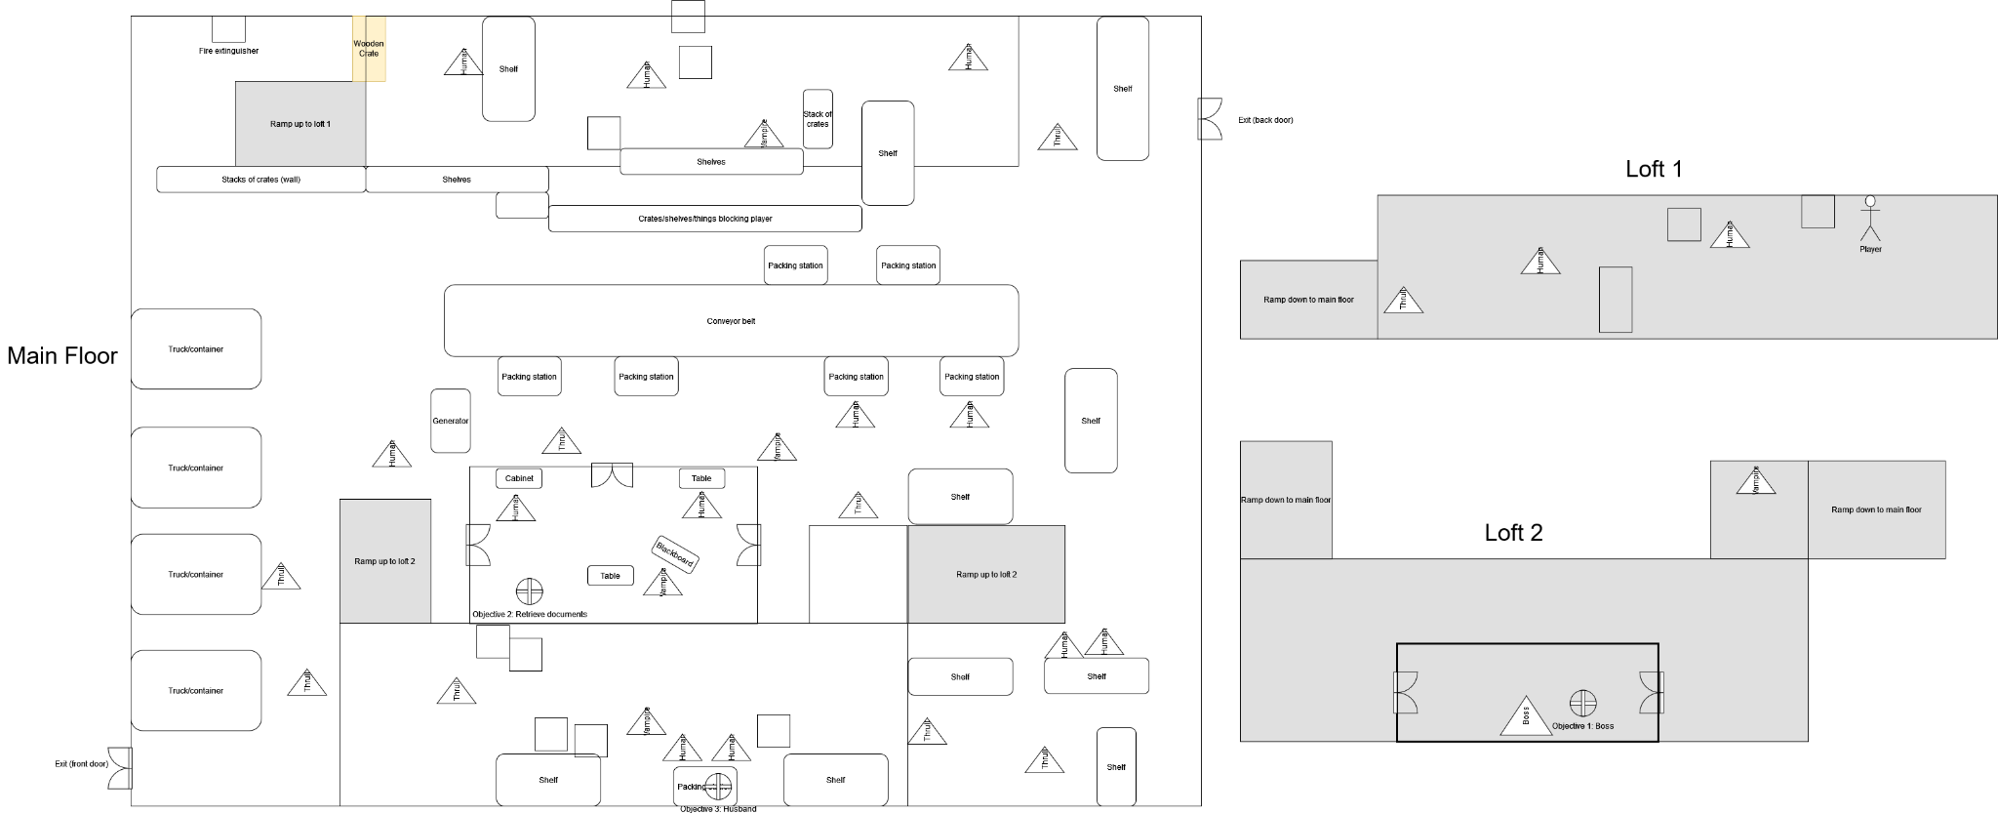
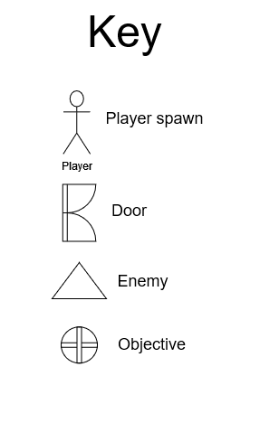
Level Design

Slide 15
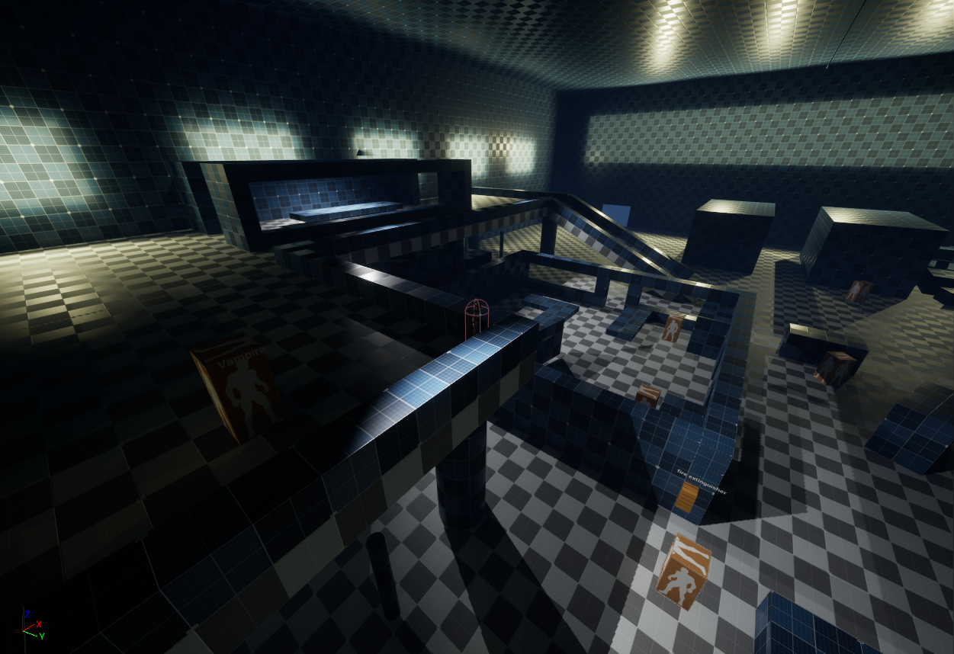
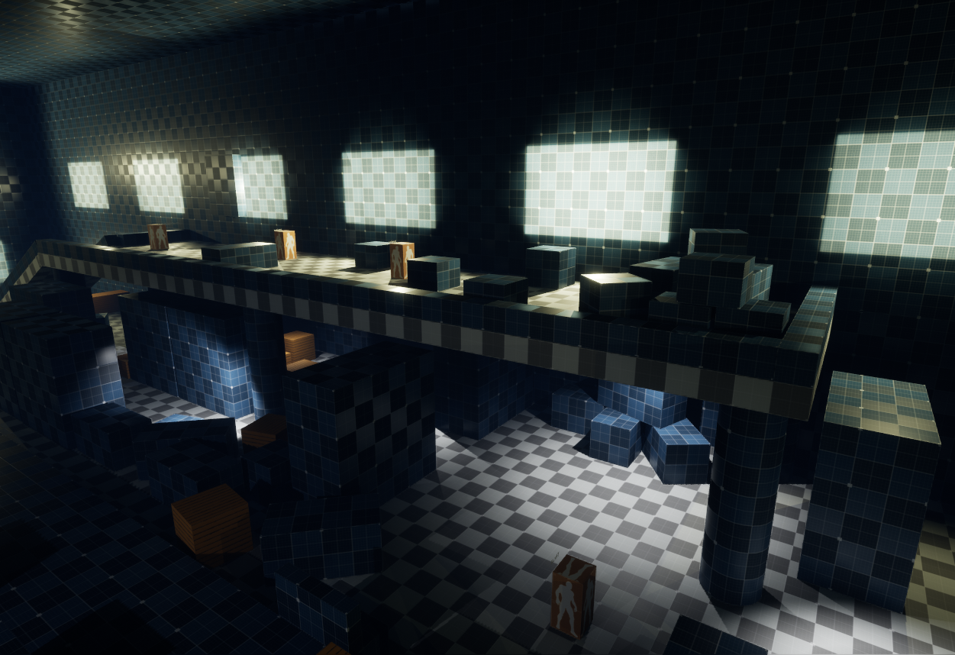
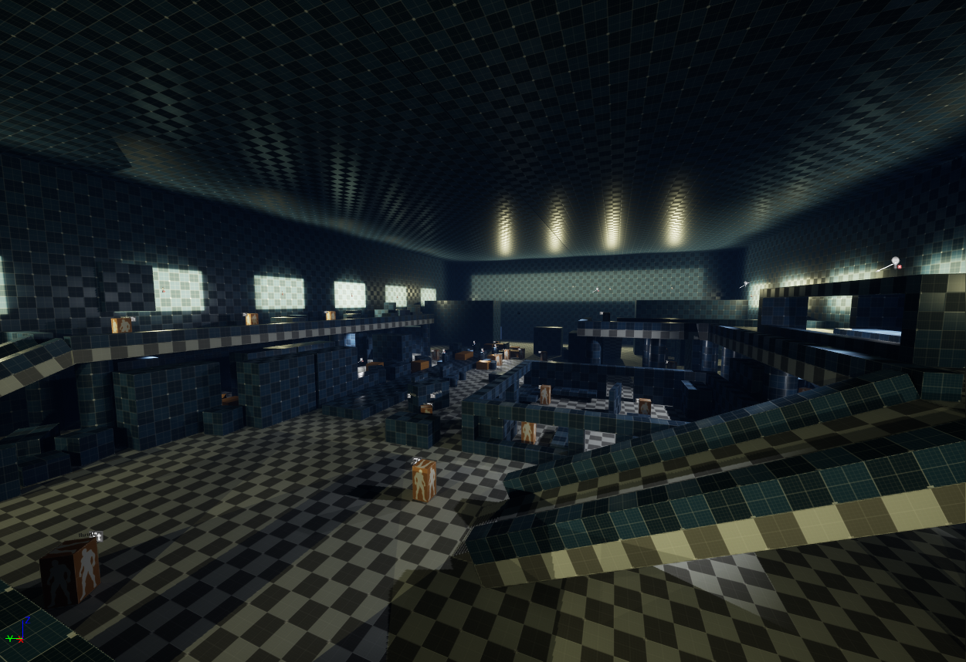
Level Design
First greybox of the level - blocking out where lighting, enemies and objects etc will be placed

Slide 16
Development Schedule
18/9
Proposal pitch
5/10
Prototype
27/10
Playtest
17/11
Final delivery
2 weeks
Full production
3 weeks
Full production
3 weeks
Polish & playtest
Current Tasks | Inventory | Combat | Environment Assets & Lighting
Planned Tasks | Objectives | Destructible Environment | Enhanced AI

Slide 17
Task List - Production Roles
Winston | Jiaxu | Yokawa Kazuya | Xinying | Kerrin | John
Tech Lead Scheduler & Task Manager | Tech Artist | Scene and Game Flow Developer | Art Lead Concept Artist | Character Design | Concept Artist
Gameplay Programmer BackEnd Developer | UIUX Programmer Front End Developer | Objectives and Score Balance | Gameplay Designer | Modelling & Rigging | Concept ui
Environment And Interaction Developer | Visual Effects and Particle Effects |  | Level Design Environment Artist | Character Animation

Slide 18
Links
Hitman
https://ioi.dk/hitman
https://hitman.fandom.com/wiki/Main_Page
Shadow Tactics
https://www.shadow-tactics.com/
https://shadow-tactics.fandom.com/wiki/Shadow_Tactics_Wiki
Vrising
https://store.steampowered.com/app/1604030/V_Rising/
https://vrising.fandom.com/wiki/V_Rising

Slide 19
Back button
Level Select
Highscore
Score
Grade icon
Settings
Each of the settings, audio visual etc
Continue
Play
Individual level icon

Slide 20
Quit
Level Select
Continue
Highscores
Settings
Exit the game, display “are you sure you want to quit?”
Go to level selection
Play the last game from “Paused menu”
Display the highscores of each level, store individual score data. Same layout as level selection
Has options for audio, visual, gameplay settings
Large animated background
Main Menu

Slide 21
Back
Level Select
Play
Highscores
Settings
Go back to main menu
Play from level selection
Level 1
Image of the Level, probably a camera view orbiting level
Level Select menu
Level Description
Objectives
Highscore menu
Score breakdown/analysis from “Best” playthrough
Level 2
Level Bar is scrollable
Level 10
Level Select/Highscores

Slide 22
Back
Level Select
Play
Highscores
Settings
Go back to main menu
Play from level selection
Large Box for all the settings, can scroll if needed
Audio
Visual
Gameplay
Others
Others
Settings

